Slide 1


Basics and Foundations
Workflow
Daniel Estévez-Barcia
daeb@natur.gl

Slide 2
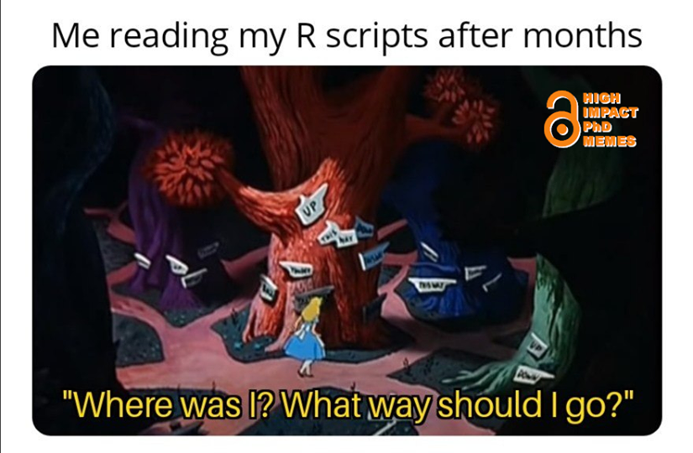
Basics and Foundations

Slide 3
Previous- Good practices
Save source (your code), not the workspace
“Think of your R processes (session) as livestock, not pets”
Restart your R session often, this may quite a few times solve your problems
Avoid using rm(list = ls()) and setwd()
Do not have all your work in a single code document
And more that….
I will be like “R que R” for the duration of the course
Basics and Foundations

Slide 4
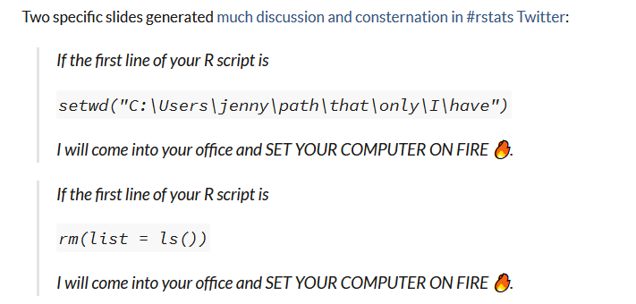
Project oriented workflow
Notes on reproducibility
DON’T DO IT!
https://www.tidyverse.org/blog/2017/12/workflow-vs-script/
https://github.com/jennybc/here_here
Basics and Foundations
Notes:
The way we will be working on this course is project oriented. This reflects my own taste, but it is most suitable for work you are going to share. Only you can decide how much you care about this. The importance of these practices has a lot to do with whether your code will be run by other people, on other machines, and in the future. If your current practices serve your purposes, then go forth and be happy

Slide 5
Project oriented workflow
Notes on reproducibility
Why?
Work is self contained. It does not matter where you place it, it will still work
setwd() only works in a particular user’s laptop. And if you work in simultaneous research, you will have to be changing it constantly
rm(list = ls()) does not create a fresh R process
“Clutter” will persist in your new script
DON’T DO IT!
https://www.tidyverse.org/blog/2017/12/workflow-vs-script/
https://github.com/jennybc/here_here
Basics and Foundations
Notes:
The way we will be working on this course is project oriented. This reflects my own taste, but it is most suitable for work you are going to share. Only you can decide how much you care about this. The importance of these practices has a lot to do with whether your code will be run by other people, on other machines, and in the future. If your current practices serve your purposes, then go forth and be happy

Slide 6


Project oriented workflow
Make your own project
Set a “working system”- this is, a number of folders where you are containing your research. For example:
LearnR
raw
The data folder contains two subfolder, one containing the raw data that should never ever be modified; and one containing processed data
The scripts folder contain code, a subfolder holding all your R working scripts; and source where you can store your R functions.
1_Data
out
code
2_Scripts
source
3_Figures
4_Papers
Basics and Foundations

Slide 7
Project oriented workflow
Make your own project
Set a “working system”- this is, a number of folders where you are containing your research.
Open Rstudio and, first things first, ensure R always start fresh:
Tools > Global Options:
Basics and Foundations

Slide 8
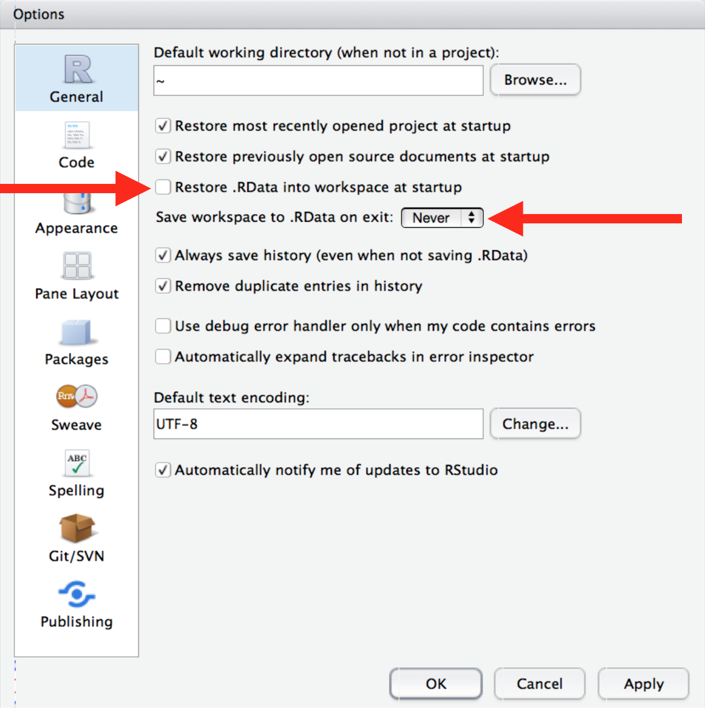
Project oriented workflow
Make your own project
Set a “working system”- this is, a number of folders where you are containing your research.
Open Rstudio and, first things first, ensure R always start fresh:
Tools > Global Options:
Basics and Foundations

Slide 9
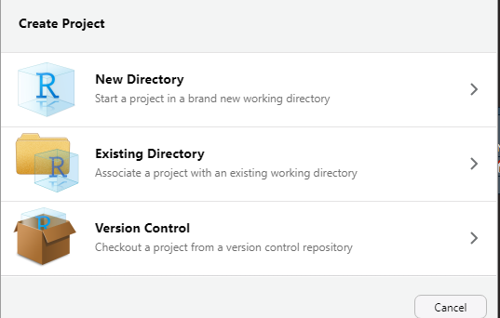
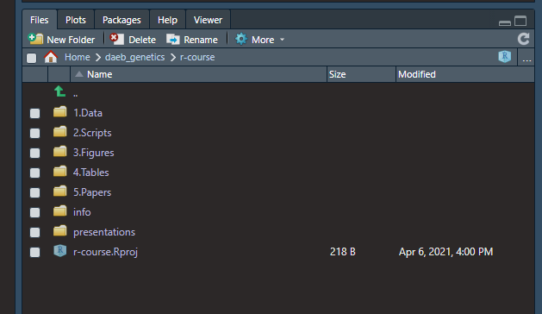
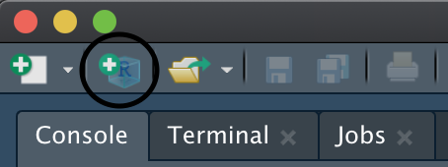
Project oriented workflow
Make your own project
Set a “working system”- this is, a number of folders where you are containing your research.
Open Rstudio and, first things first, ensure R always start fresh:
Tools > Global Options:
Create the project:
Browse and find your project Folder
Basics and Foundations

Slide 10
Why is this good?
It allows you to work on different projects simultaneously as each is defined
independently.
All paths in your scripts can be relative- think about this.
It makes you avoid the mental exhaustion resulting from looking for files all over.
Your working directory is settled where you have all the important bits.
If you move your project directory to other computer, it will still work.
Basics and Foundations

Slide 11
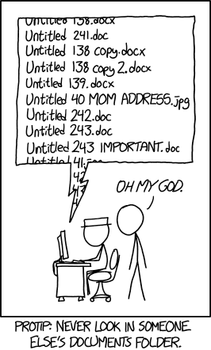
Naming your files
DO NOT use spaces, try using underscores or hyphens
You cannot actually use special characters when naming files, but you may feel tempted to used them when naming variables, DON’T
If you are versioning files and >9, use 01, 02, … if >99, 001, 002, …
Dates -> ISO 8601: YYYY-MM-DD (YYYYMMDD), just do not be American
Be loyal to your system
Allocate a README file where your raw data are detailing how you came to have them, etc.
https://xkcd.com/1459/
Basics and Foundations

Slide 12
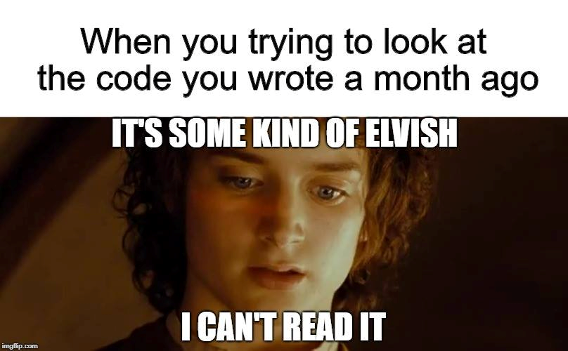
Last but not least….
Basics and Foundations

Slide 13
Last but not least….
Annotate your code, use the #
Variables, objects and functions should be clear:
df -> read.table(“folder/subfolder/01_NAFO1A_Grha_lengths.txt”, header = TRUE) ✗
grha_lengths -> read.table(“folder/subfolder/01_NAFO1A_Grha_lengths.txt”, header = TRUE) ✓
Basics and Foundations

Slide 14
Last but not least….
Annotate your code, use the #
Variables, objects and functions should be clear:
function1 -> function(x1, x2) {x1 + x2} ✗
sum -> function(number1, number2) {number1 + number2} ✓
Basics and Foundations

Slide 15
